Slide 1

Housing Trends
GW Data Bootcamp Project One
Cyrus Bakhshi
Maya Dennis
Francis J. Djamson
Jane Ellis

Slide 2
What Did We Aim to Accomplish?
We had five questions we wanted to answer:
Is it a buyer’s market or a seller’s market?
Which months have a greater spread? Why?
In which months do houses flip faster? Why?
How does temperature affect home sale/purchase volume?
For each city, what housing type (Condo, Single Family, Multi Family, or Townhouse) is the most popular? Why?

Slide 3
What Did We Discover?
January is the worst month to sell a house.
April – August are the best months to sell, with an immediate drop off in September (we believe due to the start of school)
Properties put on the market in July and August are more likely to get the asking price.
Generally single family properties and condos/co-ops are most “popular”

Slide 4
How Did We Accomplish This?
We pulled our historical housing data from Redfin
We pulled our historical weather data from Weather Underground
To answer the questions, we:
Selected cities that would represent a variety of climates and regions in the United States
Created our own index to measure home desirability (home sales over days on the market (DoM))

Slide 5
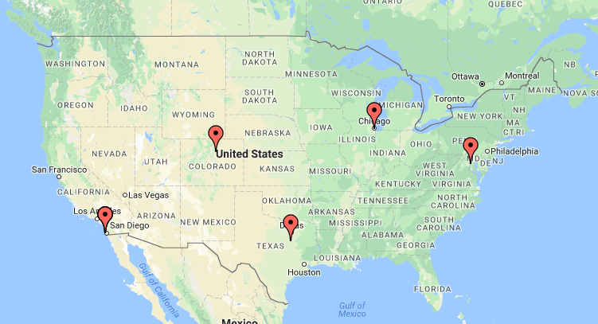
City Selection
We looked at the 2016 data for the following five cities:
Chicago
Dallas
Denver
San Diego
Washington, DC

Slide 6
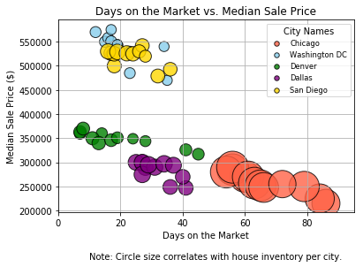
Buyer’s or Seller’s Market?

Slide 7
Buyer’s or Seller’s Market?
Longer time on market = lower median sale price
Cities with smaller property inventories see quicker turnover
Cities with larger property inventories see longer turnover times

Slide 8
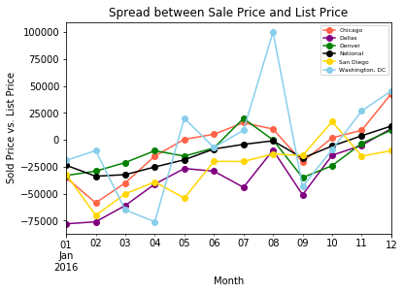
Which Months Have a Greater Spread?

Slide 9
Which Months Have a Greater Spread?
Best months = July and August
Worst months = March and September
Most erratic city= Washington, DC
April 2016 – houses averaged $75,000 below asking price
August 2016 – houses averaged $100,000 above asking price

Slide 10
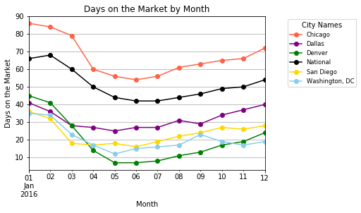
In Which Months Do Houses Flip Faster?

Slide 11
In Which Months Do Houses Flip Faster?
Best time to sell: spring/summer
Homes tend to spend less time on the market between April and August
Worst time to sell: January
Worst city: Chicago
National median (Jan): 65 days
Chicago median (Jan): 85 days

Slide 12
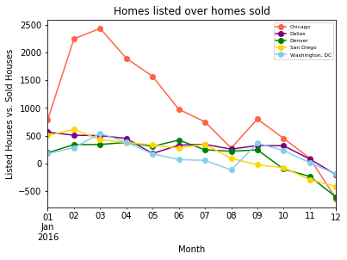
New Listings Vs. Houses Sold

Slide 13
New Listings Vs. Houses Sold
Contributor to Days on Market
Generally, new listings and houses sold each month are fairly even
Chicago is the outlier with more houses listed than sold
September is not the ideal time to list a house, as the gap increases

Slide 14
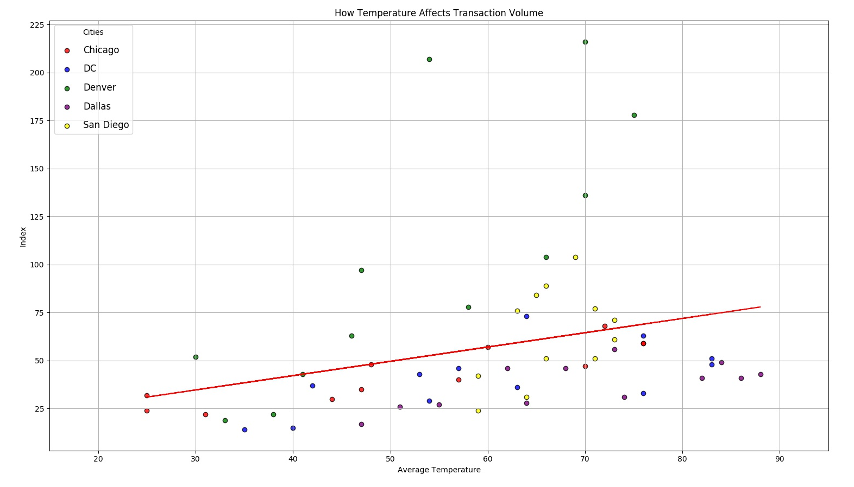
How Does Temp. Affect Transaction Volume?

Slide 15
How Does Temp. Affect Transaction Volume?
Positive correlation
We used an Index (Sales/DoM)
As temperatures rise, so does the heat in the housing markets (best for selling)
Denver saw the most dramatic changes
Followed closely by San Diego
Dallas remained consistent year-round

Slide 16
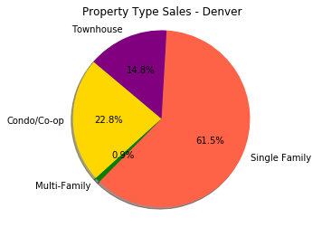
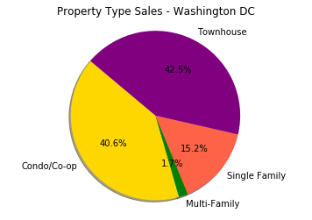
What Housing Type is Most Popular in Each City?

Slide 17
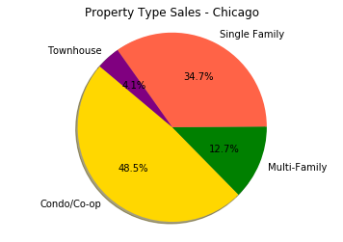
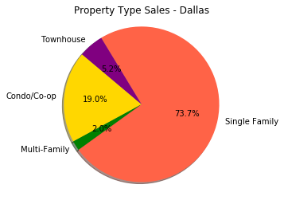
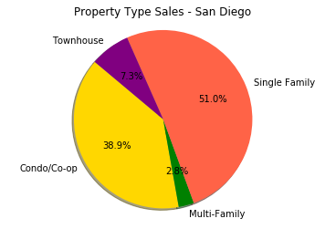

Slide 18
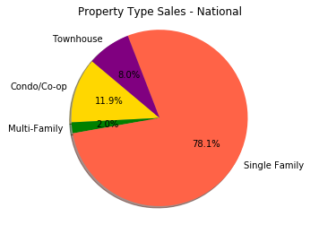
National sales by housing type

Slide 19
Recap
January is the worst month to sell a house.
April – August are the best months to sell, with an immediate drop off in September (we believe due to the start of school)
If we had to pick, we’d sell in DC in May and buy in Chicago in February.
Questions?

